Slide 1


Public Transportation Efficiency Analysis in Data Analytics
Transportation efficiency has become a growing concern in recent years. In this presentation, we will explore the importance of data analytics and visualization in analysing transportation efficiency to provide solutions for disruptions in service.

Slide 2


Topics Covered in this Presentation
Jupyter Notebook Interface
Data Extraction with Jupyter Notebook
Visualization with Python Libraries
Using Machine Learning Algorithms
Cognos Analytics in Action
Feedback Sentiment Analysis
Conclusion

Slide 3

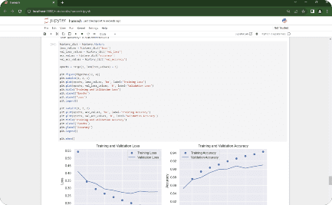
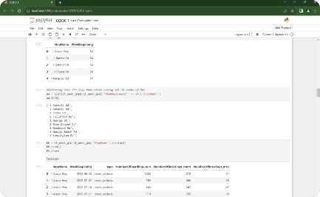
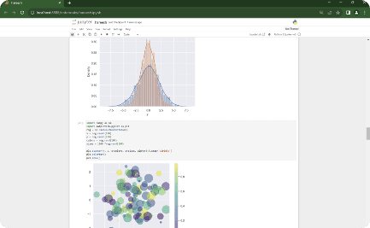
Jupyter Notebook Interface
Machine Learning Algorithms in Jupyter Notebook
Executing Code in Jupyter Notebook
Visualizing Data in Jupyter Notebook
Witness the step-by-step execution of code snippets within the Jupyter Notebook environment.
Demonstrating the power of data visualization using Jupyter Notebook's interactive capabilities.
Showcasing the implementation of KNN, CNN, and Gradient Descent algorithms in Jupyter Notebook.

Slide 4

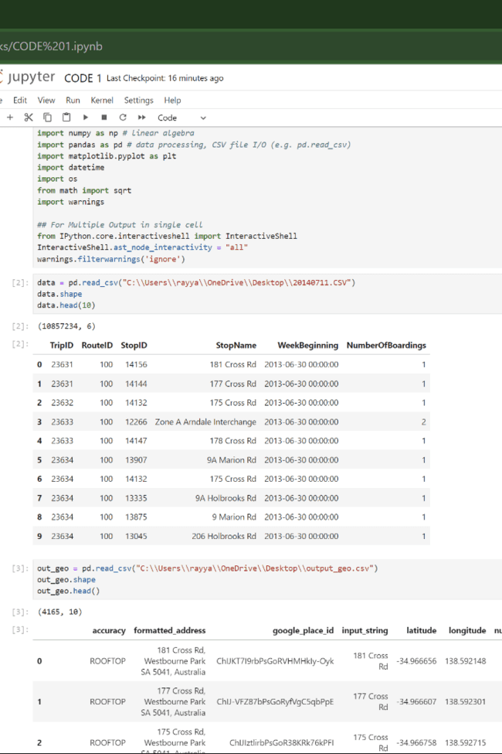
Data Extraction with Jupyter Notebook
Jupyter Notebook is widely used to extract data due to its high flexibility and user-friendly interface. For this project, we utilized Jupyter notebook to extract data from CSV files. Specifically, we extracted data from two files: 20140711.csv and output_geo.csv. By leveraging Anacondas, a popular distribution of Python, we were able to efficiently extract and manipulate the data.

Slide 5

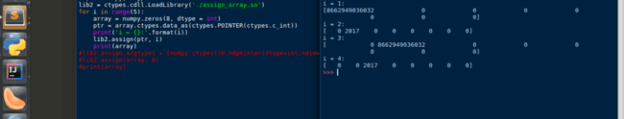
Visualization with NumPy, Pandas and Matplotlib.
In this section, we will demonstrate how NumPy and Pandas Data Frame were used for effective data visualization. The visualization techniques used include graph plotting, histograms, and scatter plots.

Slide 6




Introduction
NumPy
Pandas DataFrame
Matplotlib
NumPy, which stands for "Numerical Python," provides support for working with large, multi-dimensional arrays and matrices, along with a collection of mathematical functions to operate on these arrays efficiently. NumPy is a core library in the Python data.
A pandas DataFrame is a two-dimensional, labelled data structure commonly used in data analysis and manipulation within the Python programming language. It is one of the fundamental data structures provided by the pandas library.
Matplotlib is a widely-used Python library for creating static and interactive visualizations and plots. It is a powerful tool for data visualization and is particularly popular in the fields of data analysis, scientific computing, and machine learning.

Slide 7

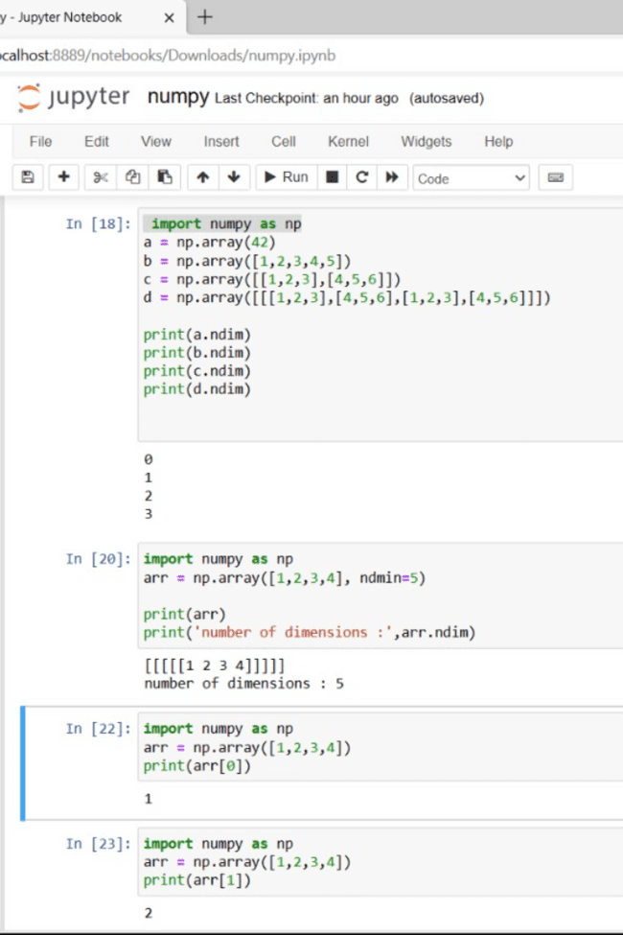
NumPy
Data Loading: NumPy aids in reading and handling datasets from various file formats.
Data Preparation: It assists in cleaning, normalizing, and converting data types.
Data Exploration: NumPy calculates statistics, revealing insights into transportation data.
Numerical Operations: Efficient element-wise operations, aggregations, and calculations are easily performed. The above operations are processed in the the adjacent screenshot.

Slide 8

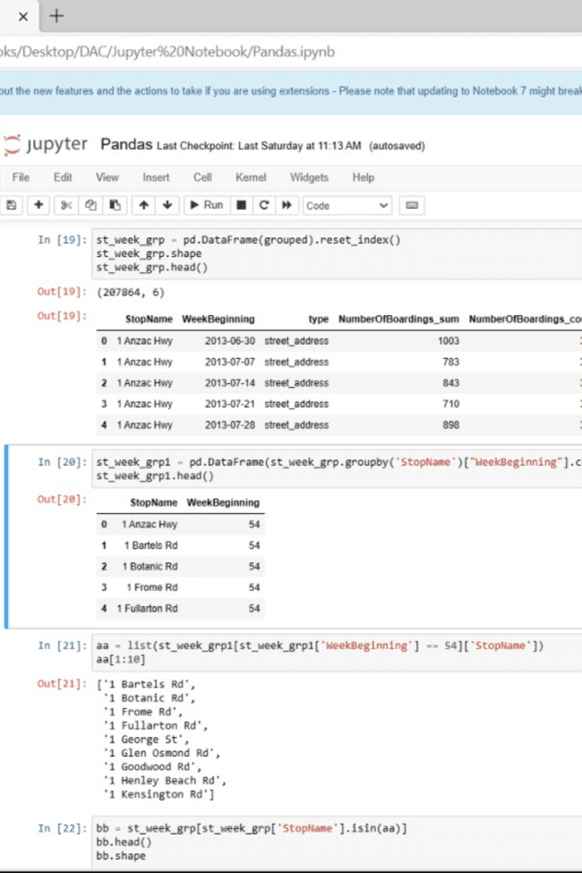
Pandas
Data Import: Pandas reads transportation datasets from various formats such as CSV, Excel, SQL databases, or web sources, into DataFrame structures.
Data Exploration: Pandas provides tools for exploring and summarizing data, including methods for checking basic statistics, identifying missing values, and understanding data distributions.
Data Manipulation: Pandas filters, selects, merges, and reshapes data efficiently.
Time Series Analysis: Supports analysis of time-related trends in transportation data.

Slide 9

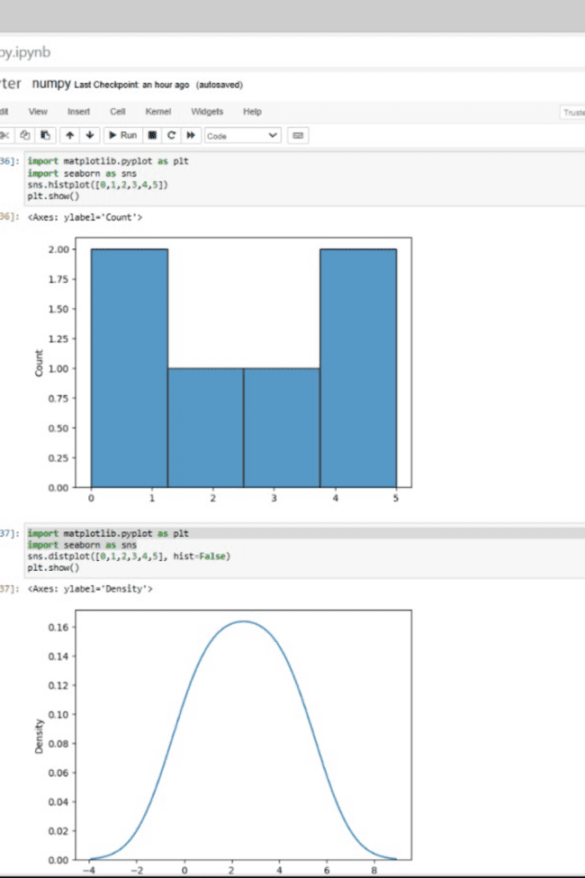
Matplotlib
Data Visualization: Matplotlib creates diverse transportation data visualizations.
Exploratory Data Analysis(EDA): Helps explore data, find trends, and detect outliers.
Performance Metrics: Visualizes traffic patterns and efficiency metrics.
Customization and Interactivity: Offers flexibility and interactivity for effective data representation.

Slide 10


Machine Learning Algorithms
KNN, CNN, and Gradient Descent are some of the most popular machine learning algorithms used for data analysis. In this section, we will discuss how these algorithms are useful to transportation efficiency data's analysis and their results.
KNN can help in real-time traffic management and route optimization, CNN can provide automated insights from visual data for better traffic monitoring, and Gradient Descent plays a crucial role in training predictive models for various transportation-related applications.
The results of these algorithms can lead to more efficient transportation systems, reduced congestion, lower costs, and improved overall transportation experiences.

Slide 11

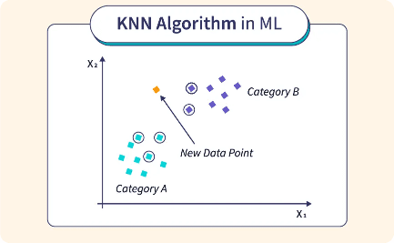
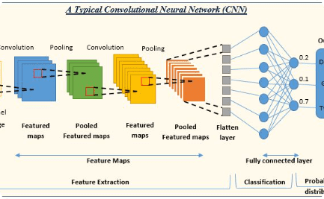
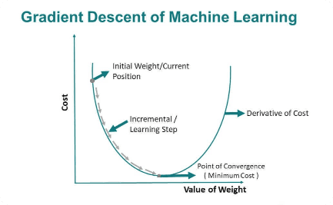
Algorithms
K-Nearest Neighbours (KNN)
Convolutional Neural Network (CNN)
Gradient Descent
With the help of Gradient Descent, we optimized the parameters of our machine learning models, improving their accuracy and performance.
Utilizing the KNN algorithm, we were able to classify and predict various attributes of the public transportation efficiency data set.
By implementing CNN, we achieved accurate image classification and analysis, contributing to the overall efficiency analysis of public transportation.

Slide 12
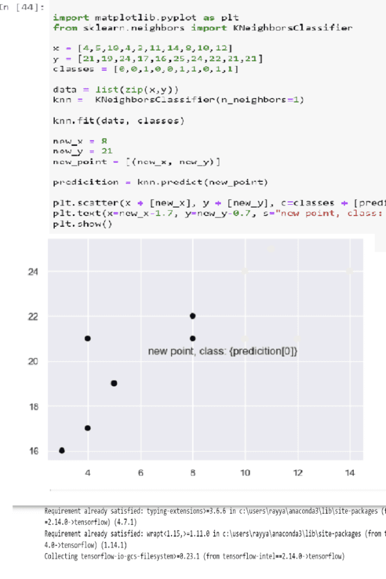

K-Nearest Neighbors (KNN) Algorithm
K-Nearest Neighbours (KNN) is a machine learning algorithm that classifies or predicts based on the majority class or average value of its 'k' nearest data points in a feature space, where 'k' is a user-defined parameter. Our team members implemented the KNN algorithm using Jupyter Notebook. The following screenshot depicts real-time implementation of the algorithm.

Slide 13

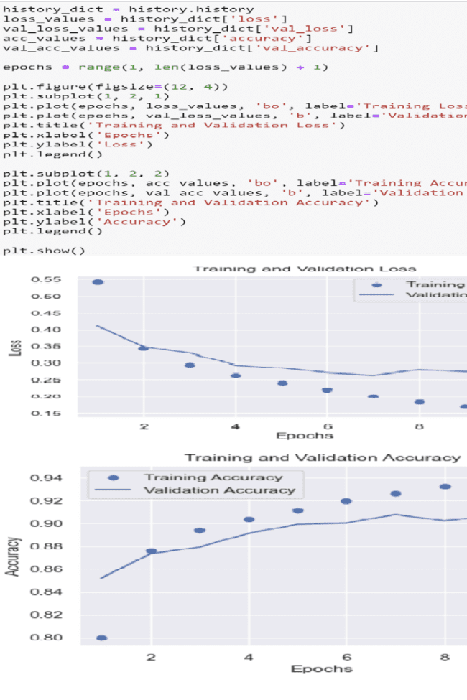
Convolutional Neural Networks (CNN)
A Convolutional Neural Network (CNN) is a deep learning algorithm designed for image and spatial data processing. It uses specialized layers to automatically learn and detect features in data, making it particularly effective for tasks like image classification and object recognition. CNNs are inspired by the human visual system and employ convolutional layers to extract hierarchical patterns and information from input data. You can see the execution of the CNN model in Jupyter Notebook in the following screenshot.

Slide 14

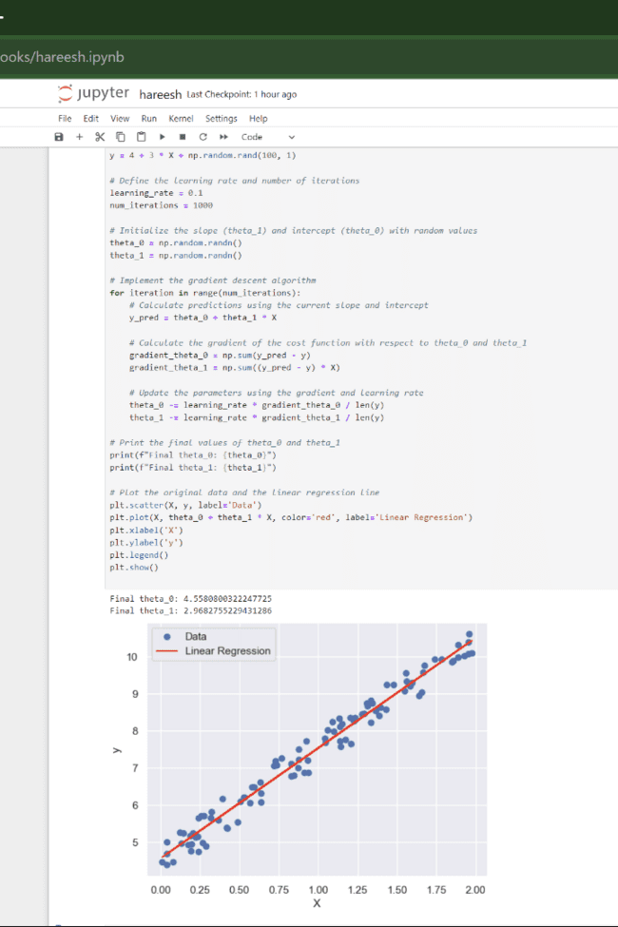
Gradient Descent Algorithm
Gradient Descent is an optimization algorithm used in machine learning to minimize the error or loss of a model. It iteratively adjusts model parameters in the direction of steepest descent (negative gradient) to find the minimum of a cost function. This process continues until it converges to an optimal set of parameters, improving the model's performance. You can see the Gradient Descent code and output in the following screenshot of Jupyter Notebook.

Slide 15



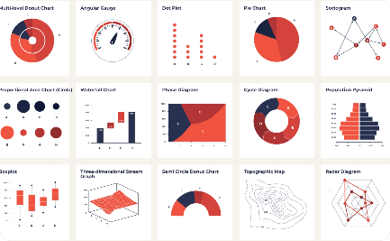

Cognos Analytics in Action
Data Exploration
Interactive Dashboard
Reporting and Sharing
Through Cognos Analytics, we were able to explore the data and gain valuable insights into the public transportation efficiency, enabling us to make data-driven decisions.
With the interactive dashboards in Cognos Analytics, we created visually appealing representations of the analysed data, making it easier to understand and interpret for stakeholders.
Cognos Analytics provided us with the ability to generate comprehensive reports and share them with relevant stakeholders, ensuring effective communication of the analysis results.

Slide 16

Feedback Sentiment Analysis
Sentiment analysis is a vital tool for examining public feedback on public transportation. Commuters offer a mix of positive and negative opinions, with punctuality emerging as a major concern. Delays caused by traffic congestion frustrate passengers, leading to dissatisfaction. Overcrowding due to delays also strains resources. Additionally, improving vehicle quality is a key suggestion for enhancing public transportation efficiency and passenger satisfaction. In summary, sentiment analysis helps transportation management understand and address issues related to punctuality, overcrowding, and vehicle quality to improve the public transportation experience.

Slide 17
Positive and Negative Feedbacks
Safety :
Overcrowding and Reliability :
Lower accident rates :- Public transport is generally safer than private car travel, thanks to professional drivers, regular maintenance, and dedicated lanes.
Peak-time congestion : Rush hours can make public transport overcrowded, causing discomfort and delays. Reliability issues: Some systems may experience delays or breakdowns, inconveniencing passengers.
Cost-Effective :
Infrastructure maintenance :
Economical for users :- Public transport is often more cost-effective than owning and maintaining a private vehicle, considering expenses like fuel, insurance, and maintenance
Capital Expenditure :- Ongoing investments are needed to maintain public transport infrastructure, which can strain public budgets.

Slide 18

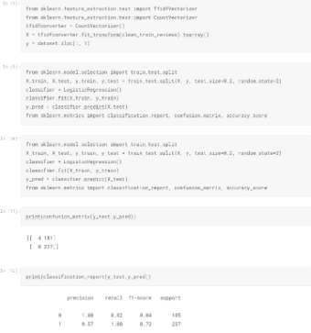
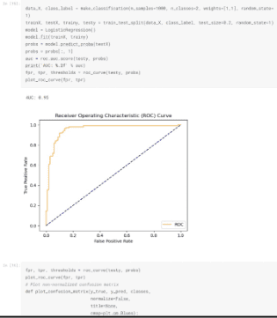
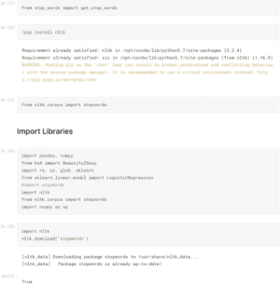
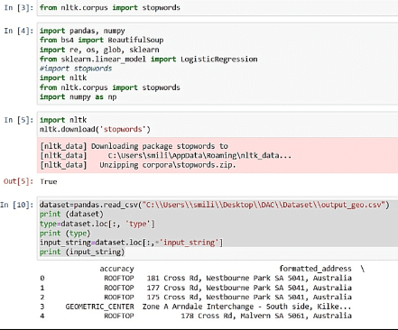

Slide 19

Conclusion
Through the utilization of data analytics techniques, we have conducted an in-depth analysis of public transportation efficiency. Our findings provide valuable insights and recommendations for improving the overall efficiency of the system, resulting in a more sustainable and user-friendly transportation network.

